Slide 1
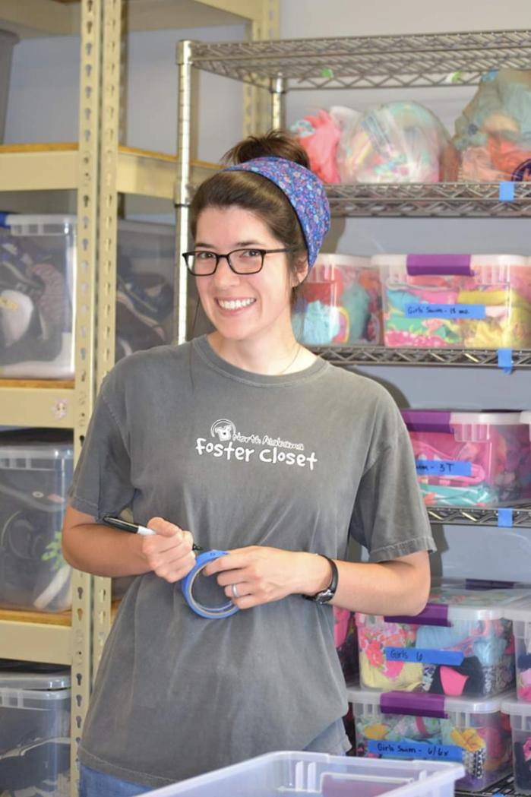
Mrs. Emily Harris

Slide 2
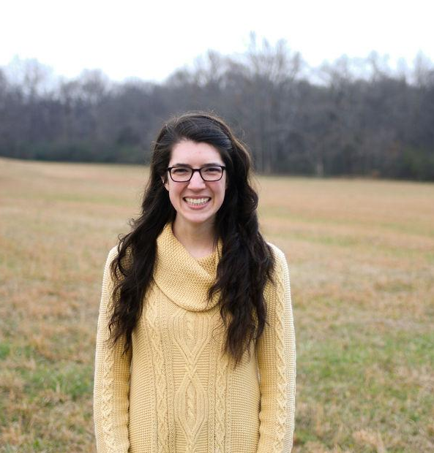
ABOUT ME
(Must include picture AND video)
I was born and raised just down the road in Athens, Alabama. I graduated from Athens High School then went on to attend Auburn University, where I graduated with a degree in Chemistry Education. Besides teaching, I enjoy Bible study, gardening, cooking/baking, song-writing, and spending time with family. I am married to my best friend, Will, who works as a community pharmacist in Ardmore.
I've worked with chemistry content and students for a long time. In Auburn, I worked in different chemistry settings as a one-on-one tutor, a coordinator of weekly review sessions, and an assistant in a blended learning classroom. I then interned in chemistry classes at Auburn High School in Auburn, Alabama.
I've known that I've wanted to be a teacher for a long time because I enjoy helping students reach their full potential and succeed in typically challenging classes. I am passionate about what I teach, but even more passionate about who I teach - my students.
I welcome parent/student communication! Please feel free to contact me with any questions or concerns by email.
I'm looking forward to a great year of learning and growing together!
Link to re-watch welcome video: https://youtu.be/QHRtLx0ouYc

Slide 3
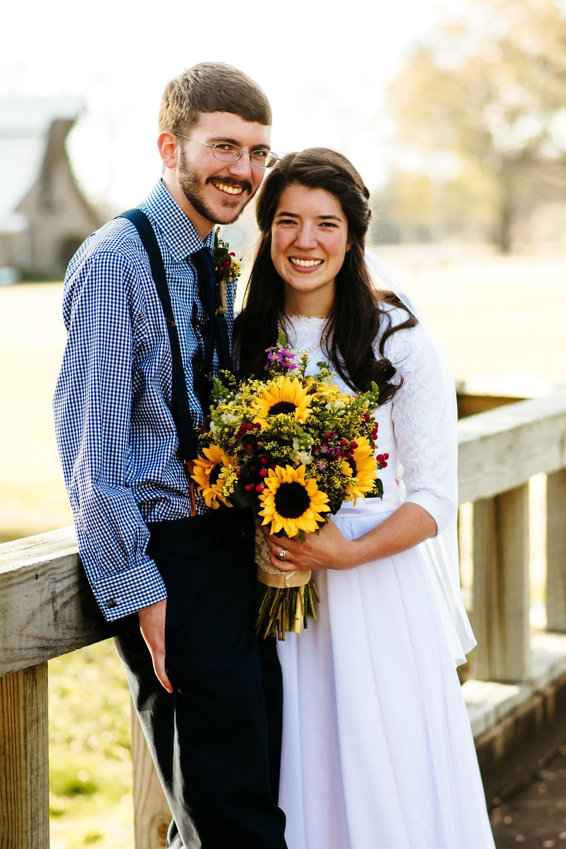
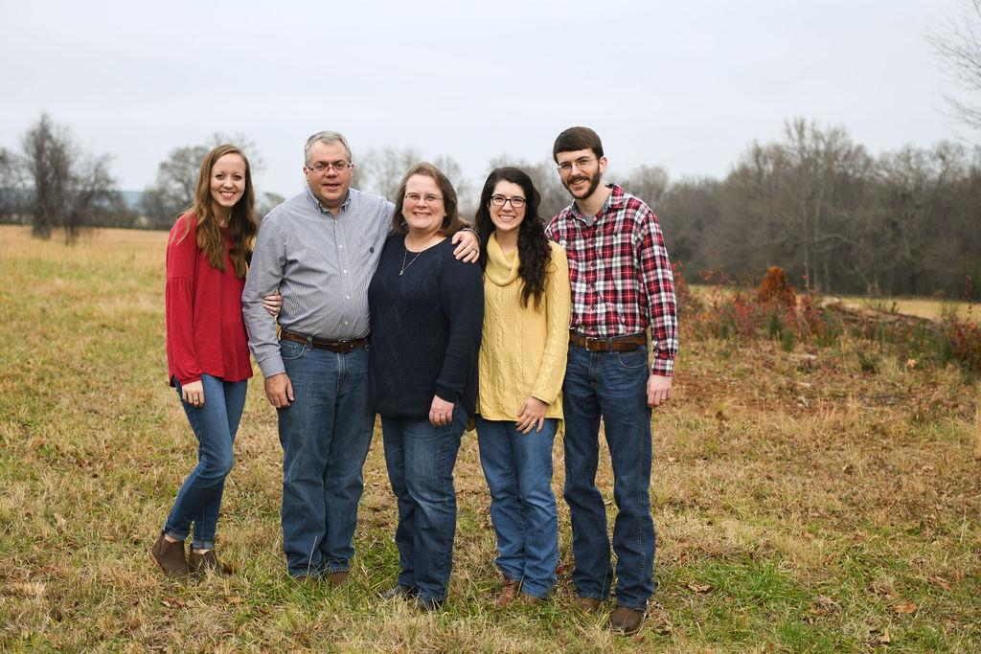
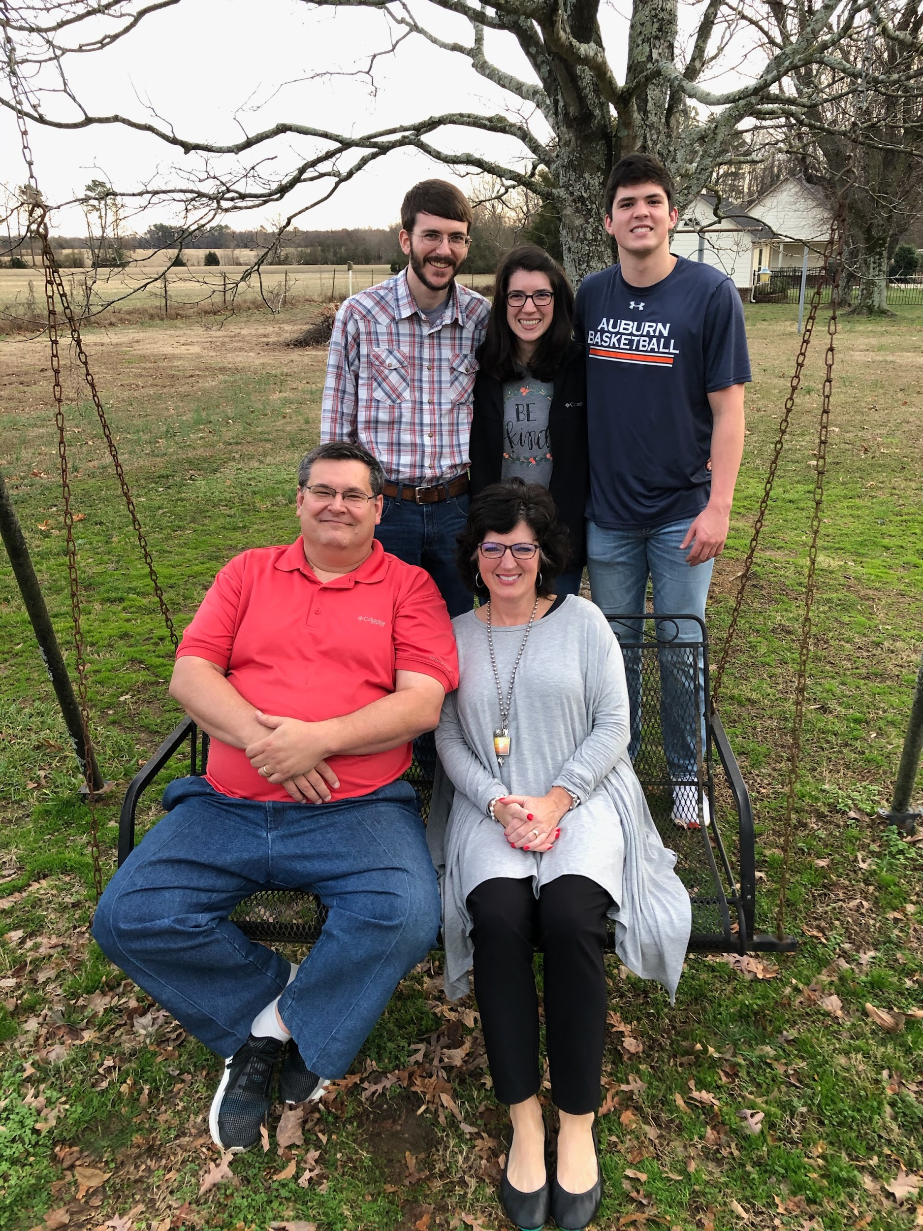
FAMILY

Slide 4
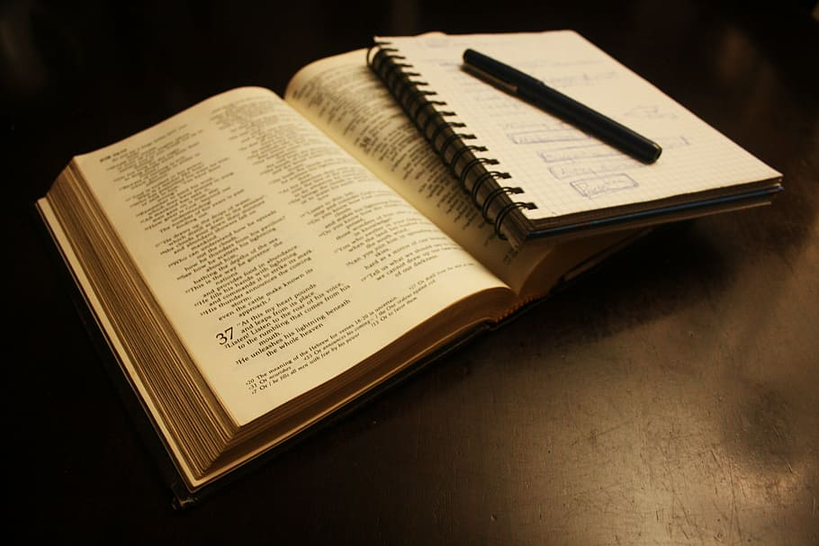
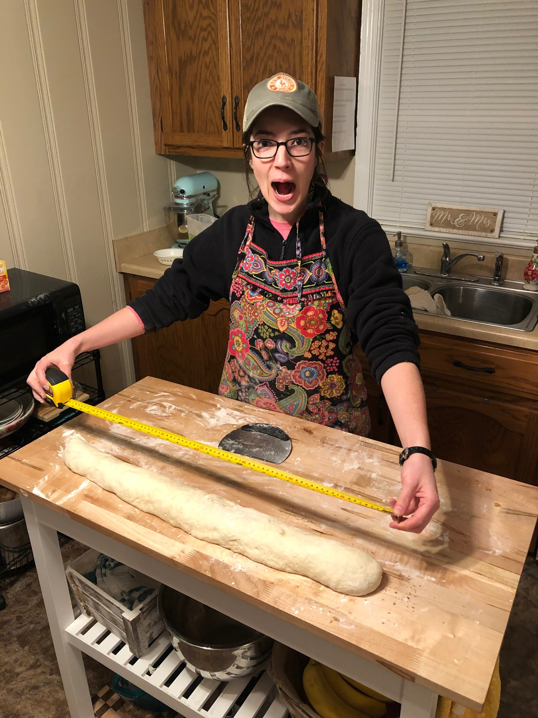
FAVORITE THINGS

Slide 5
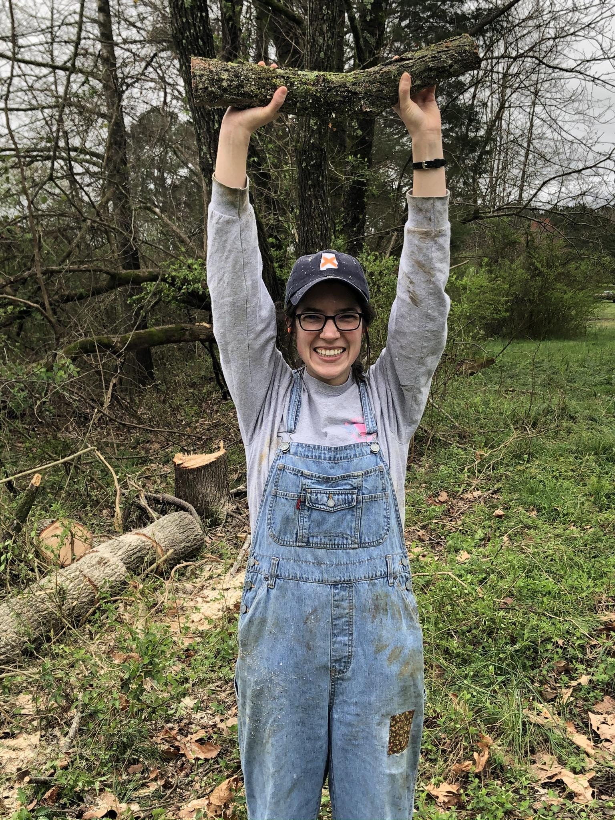
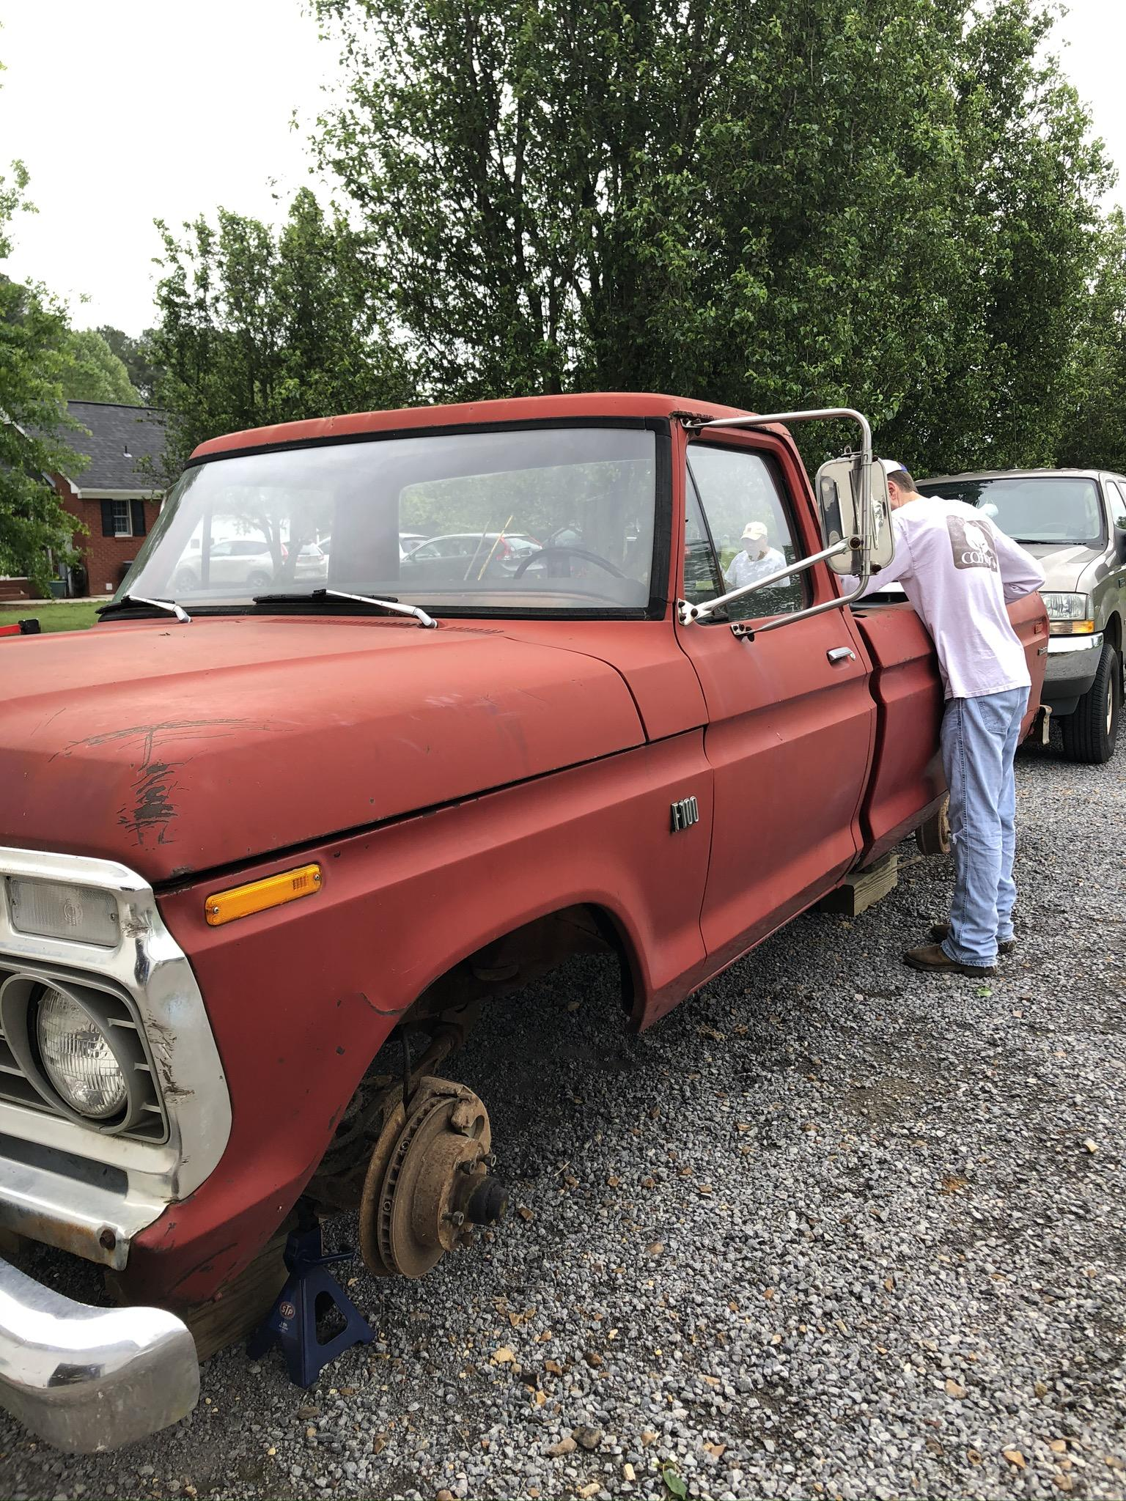
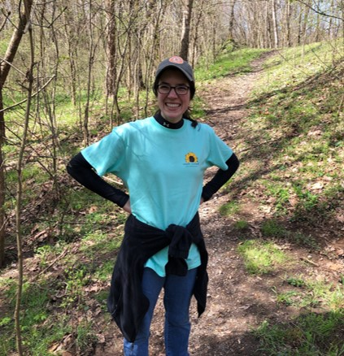
FAVORITE THINGS

Slide 6
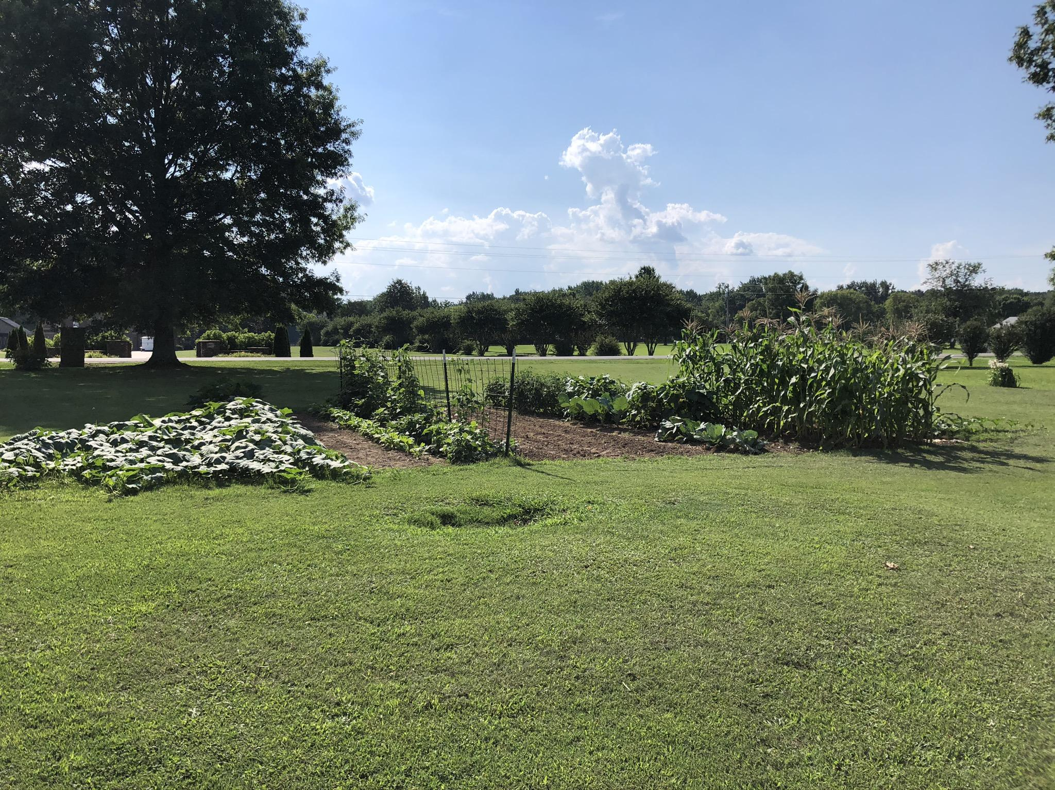
Gardening

Slide 7
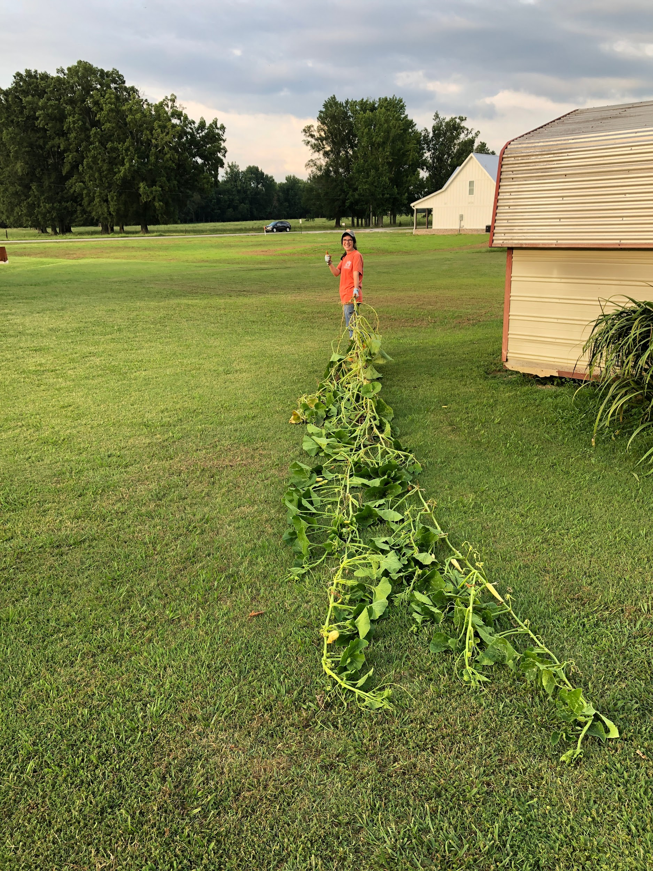
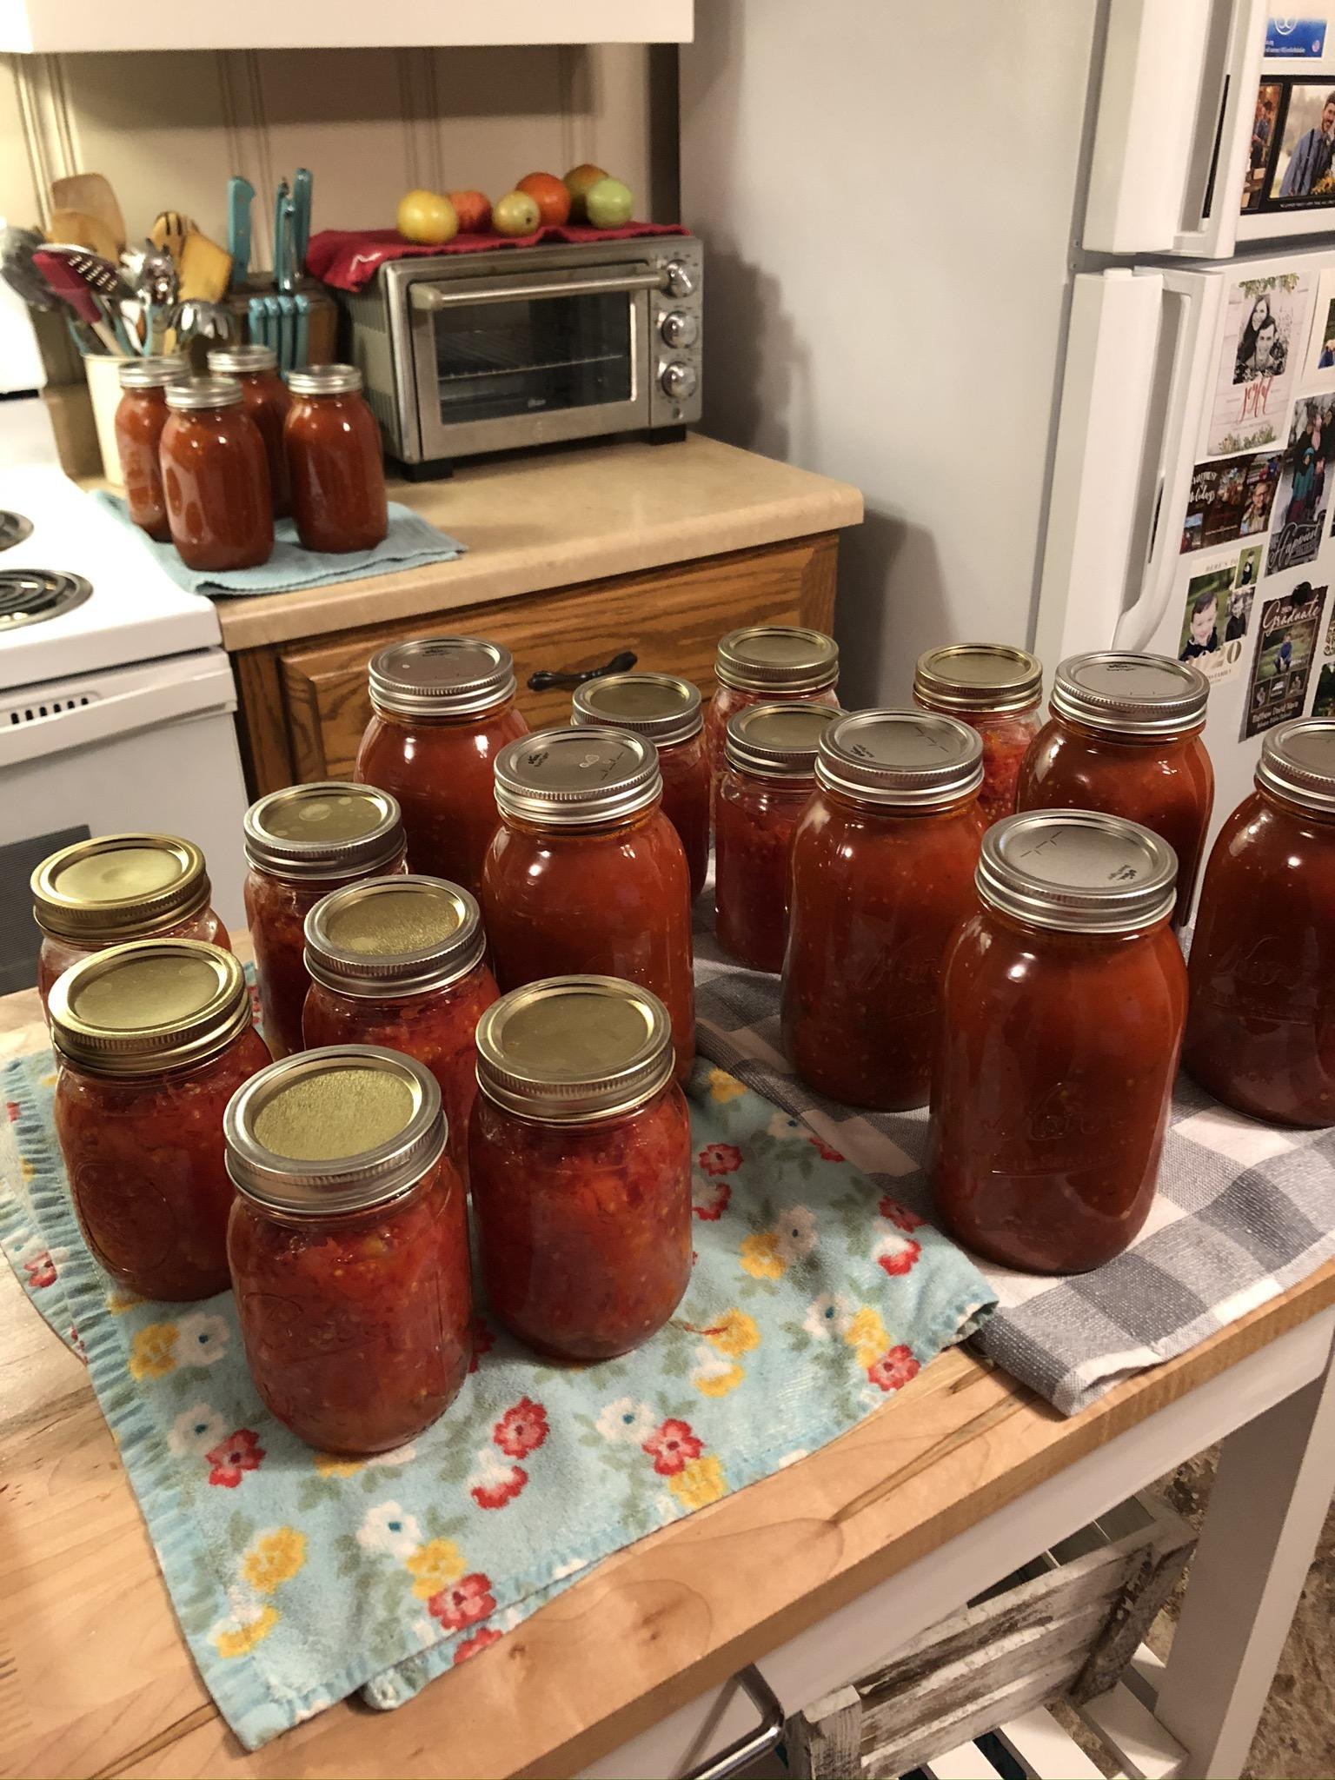
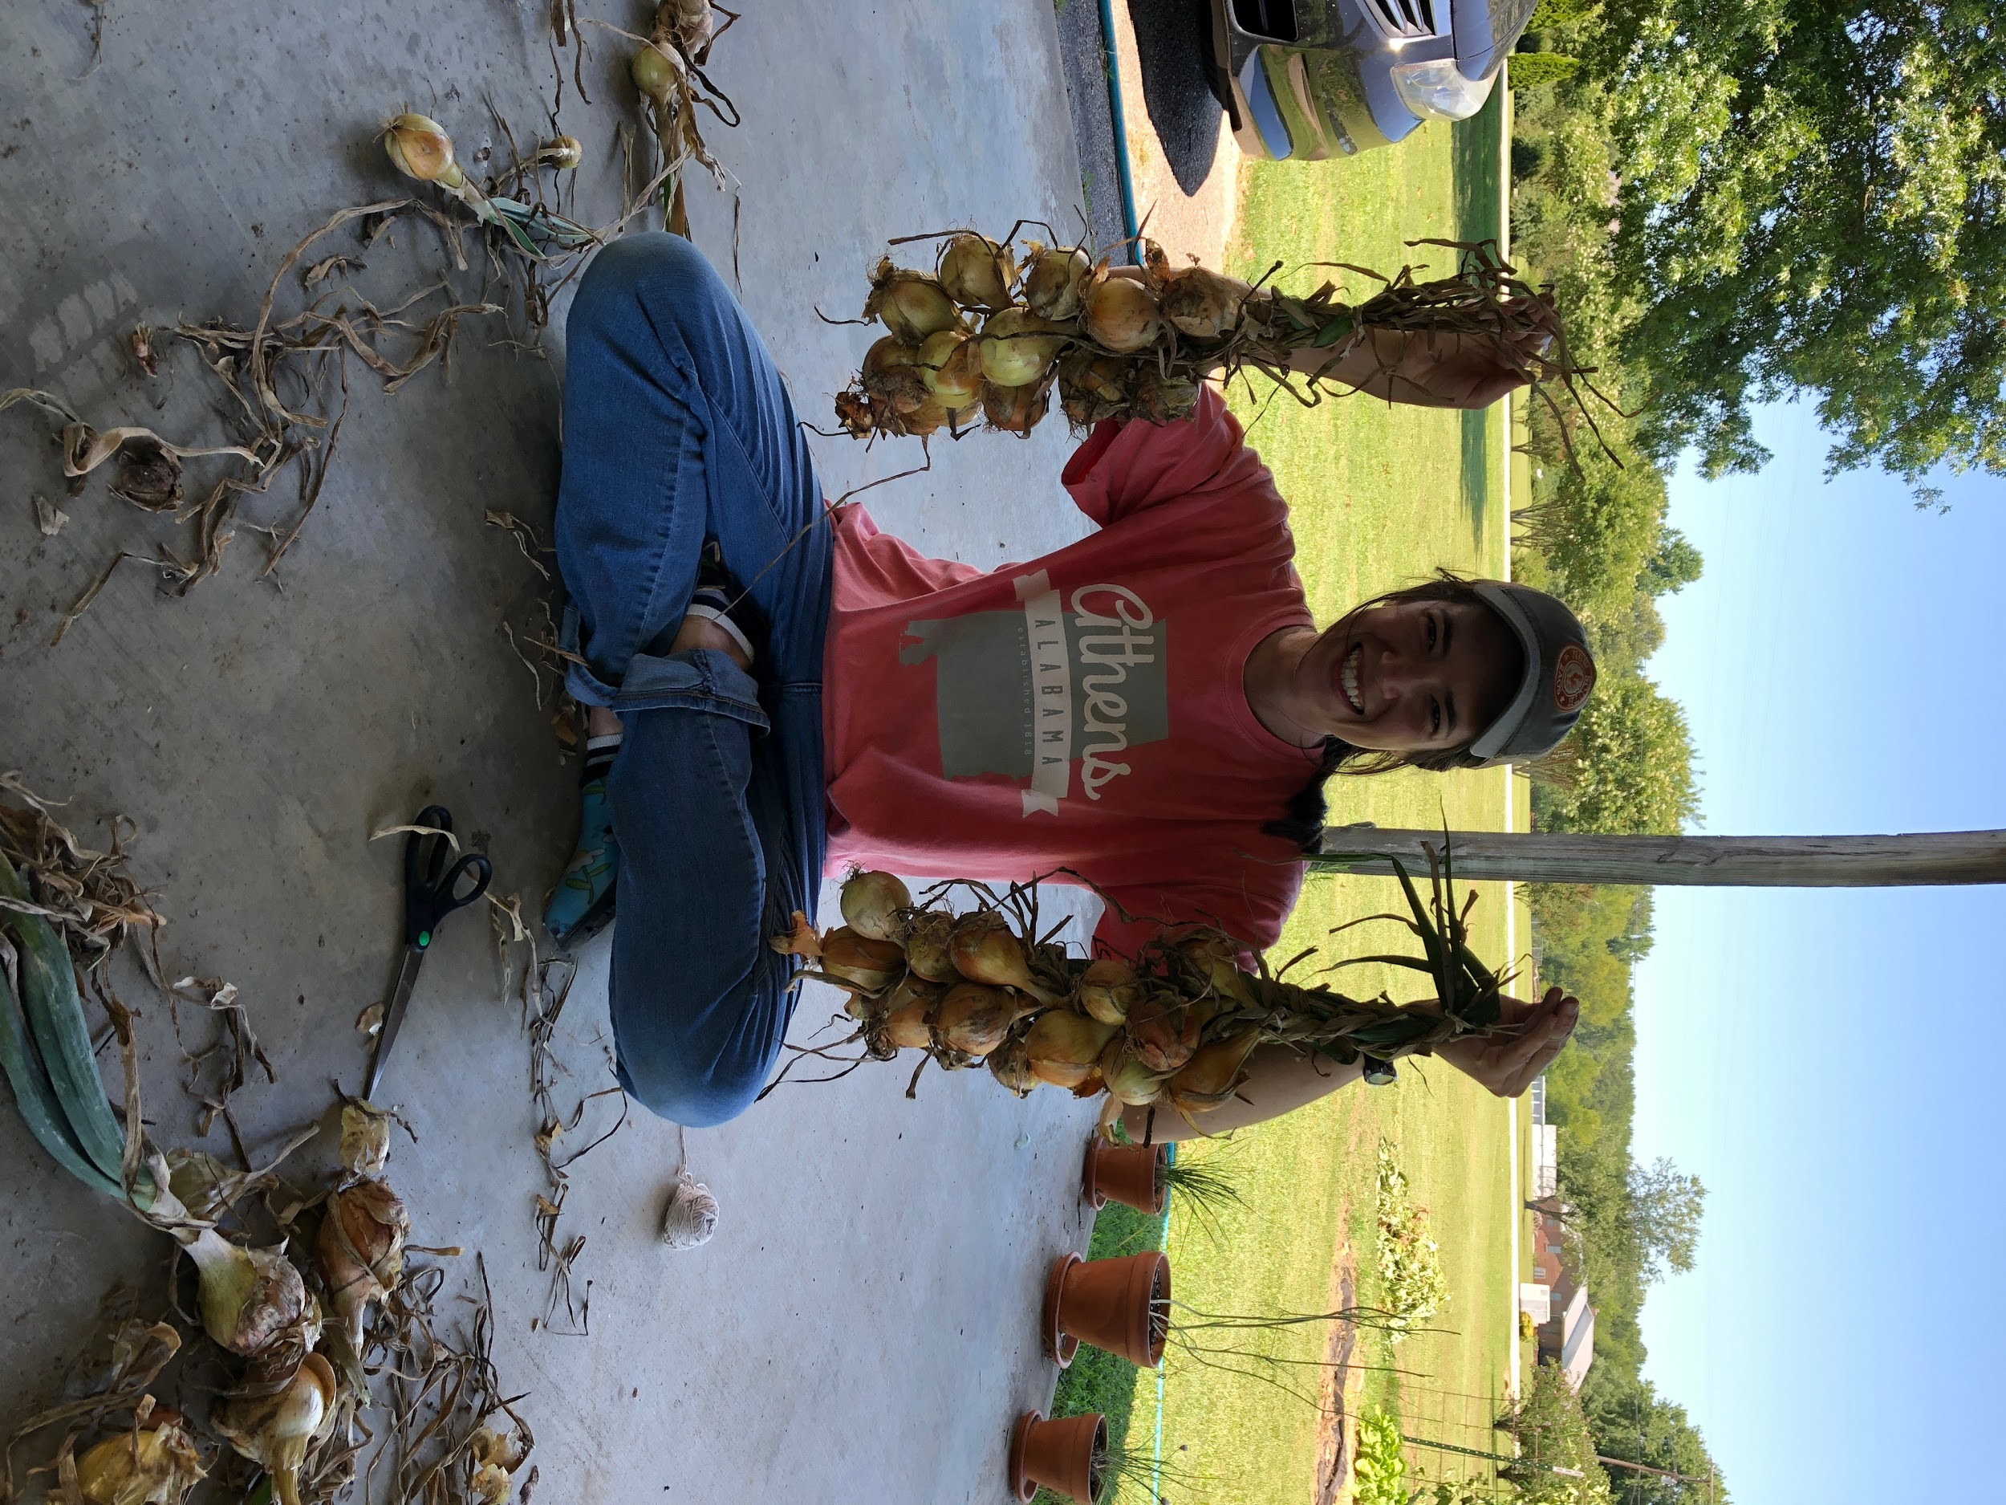

Slide 8
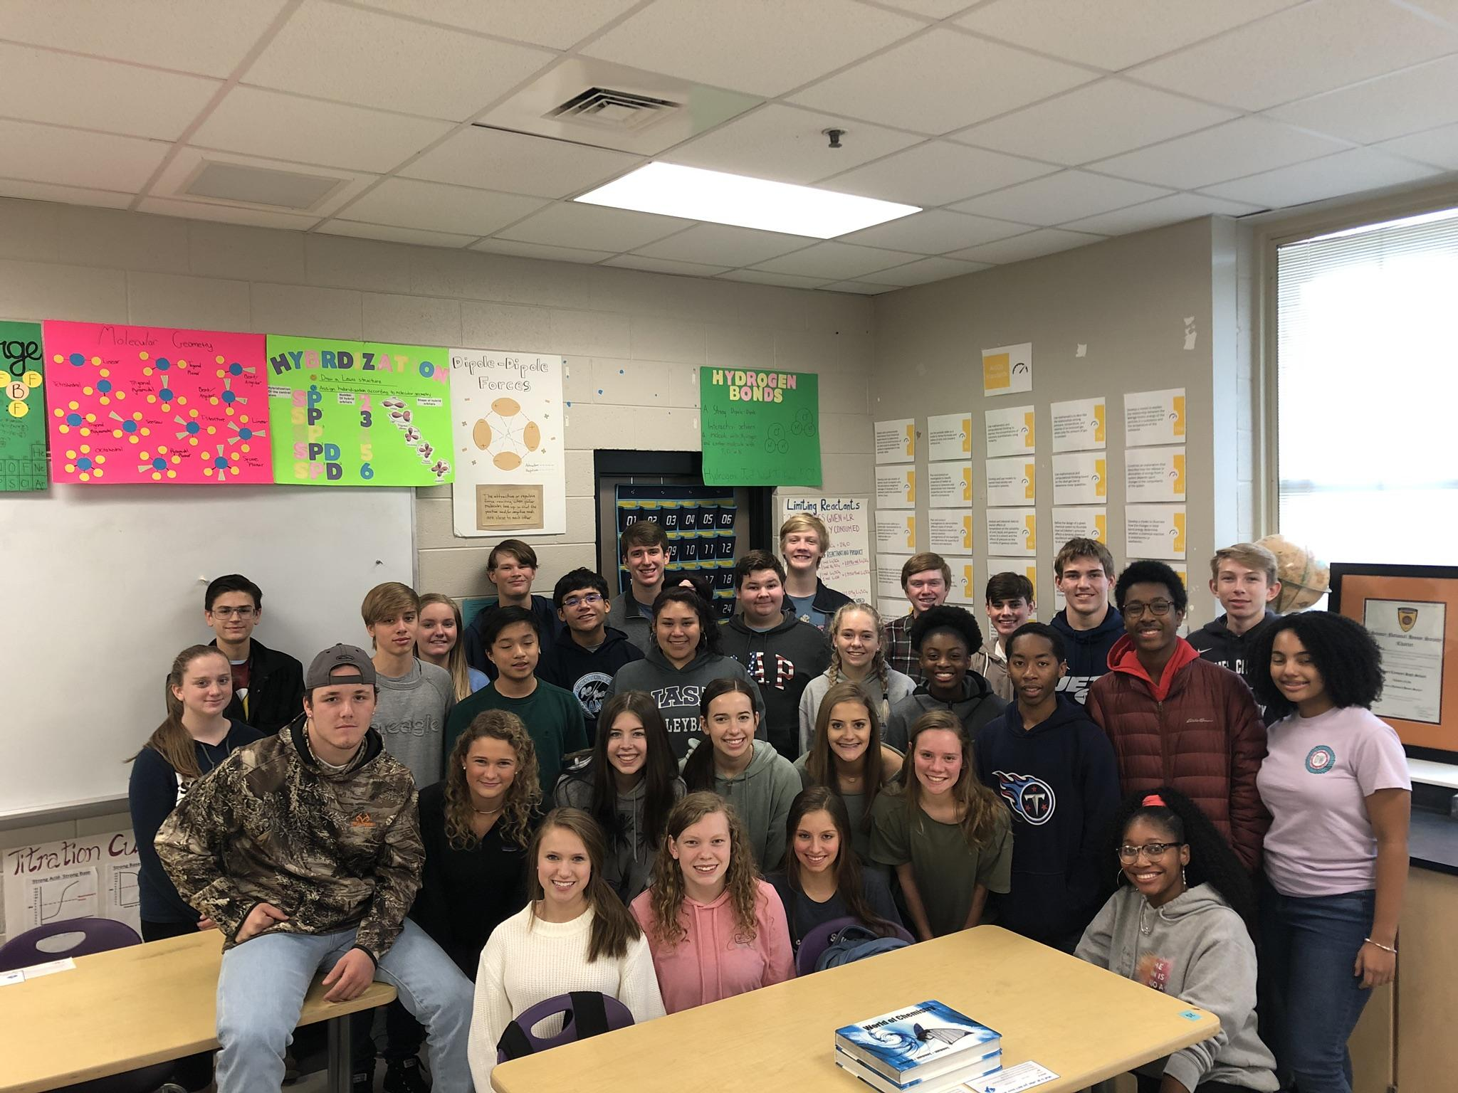
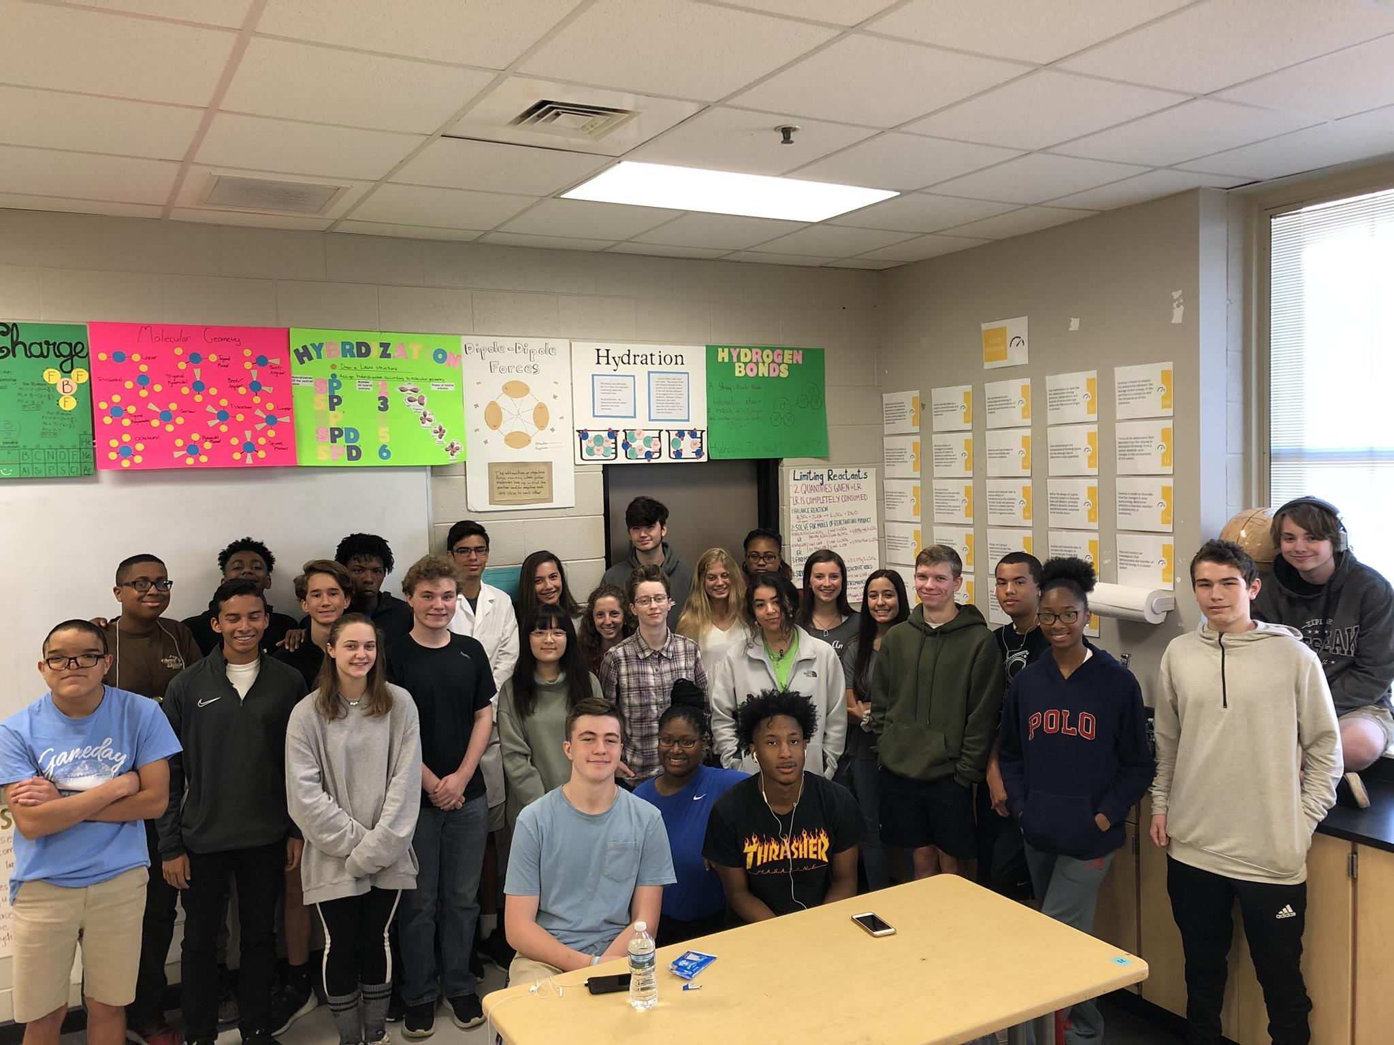
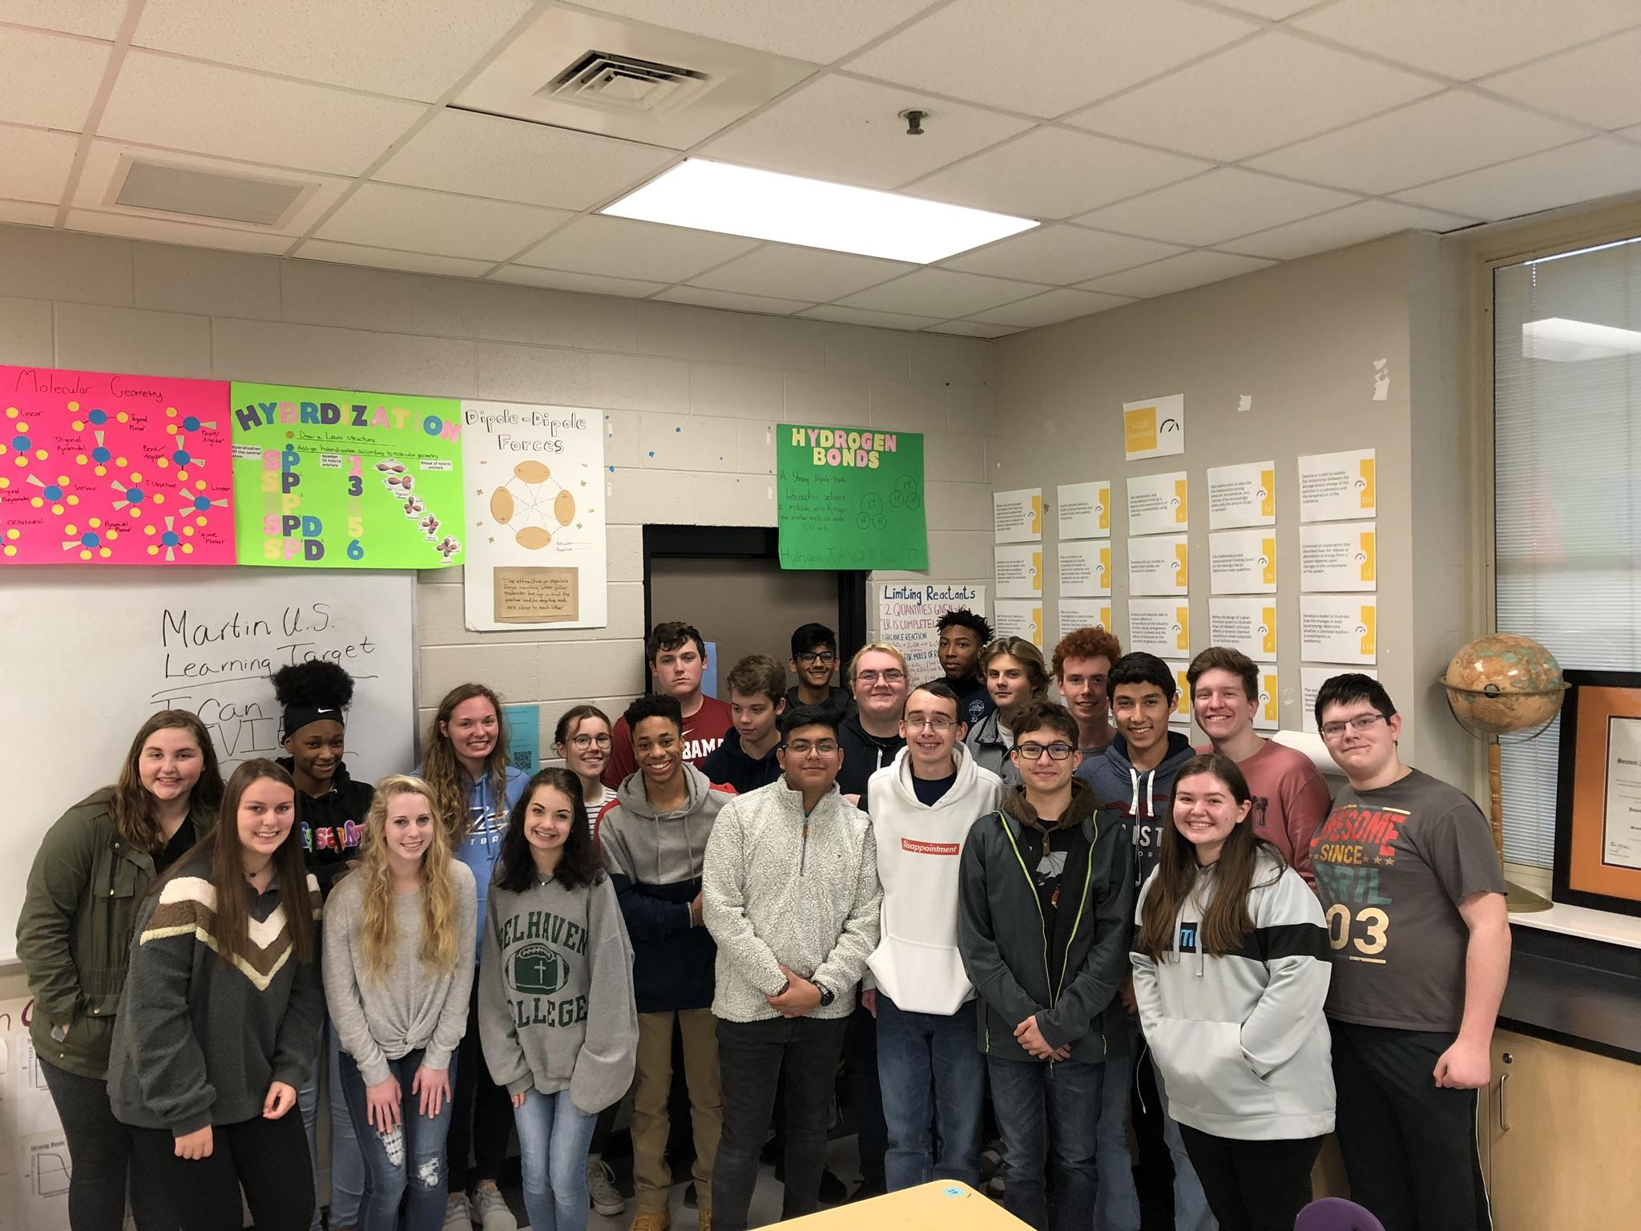
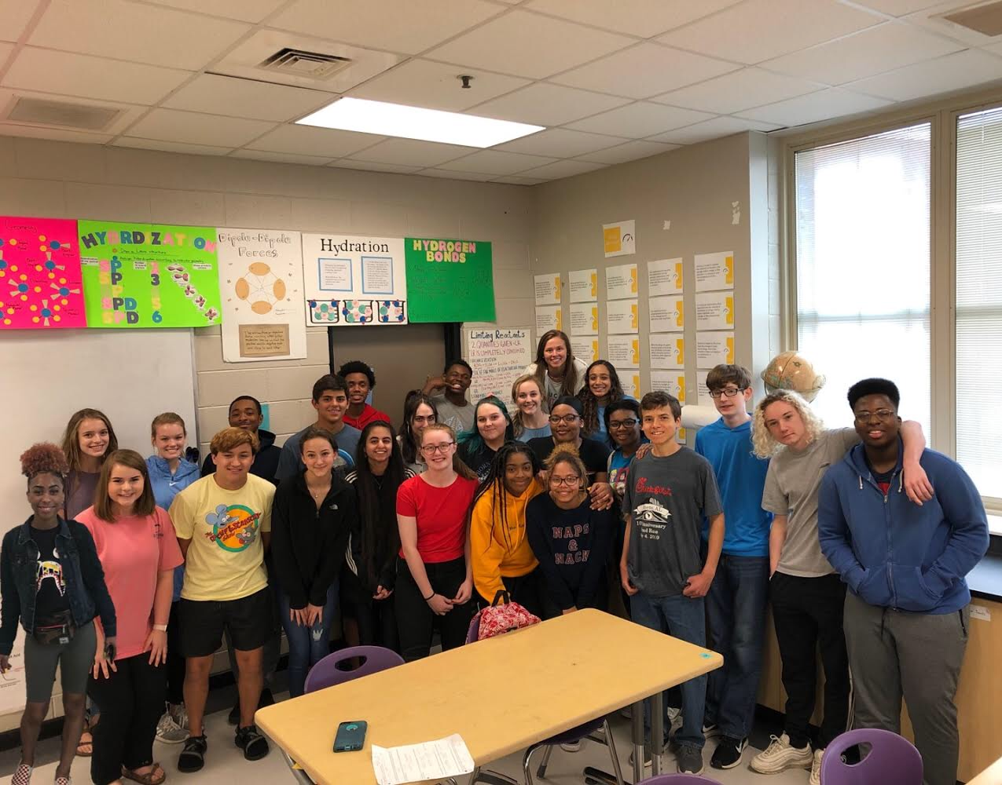
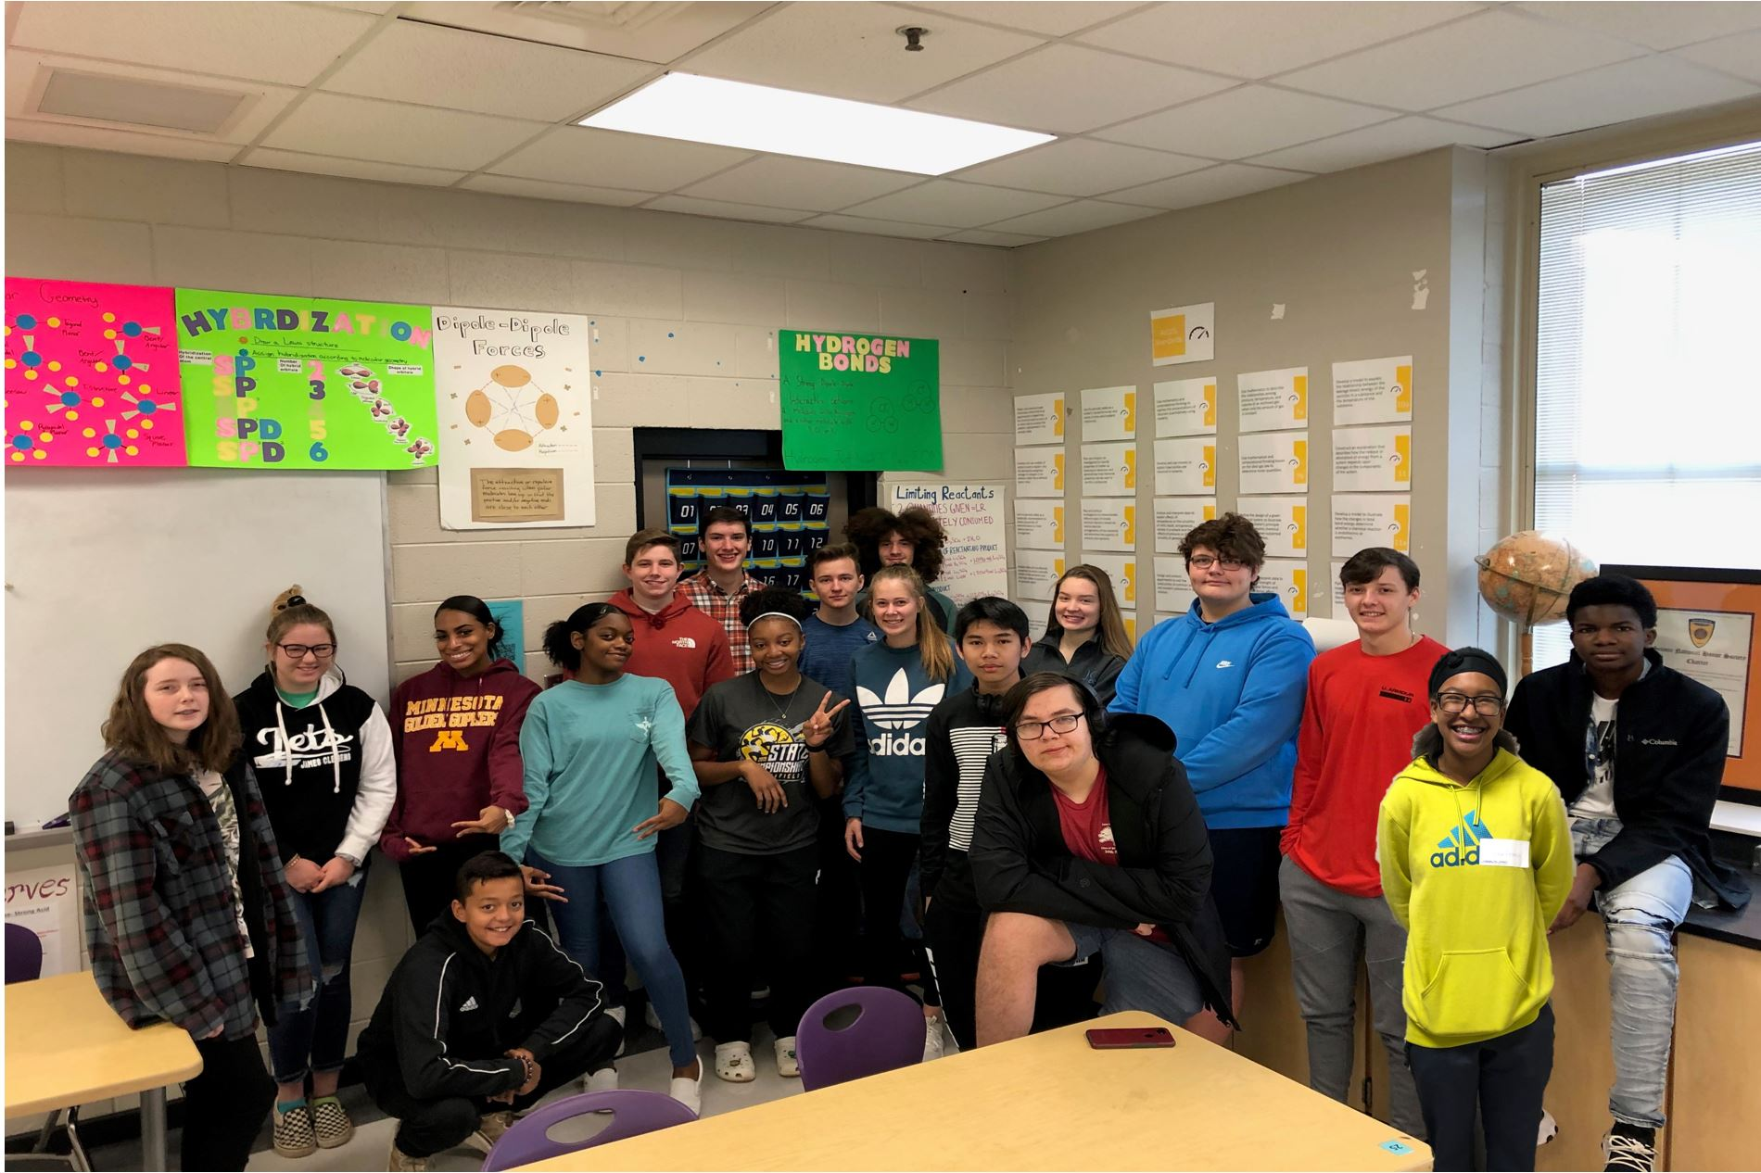
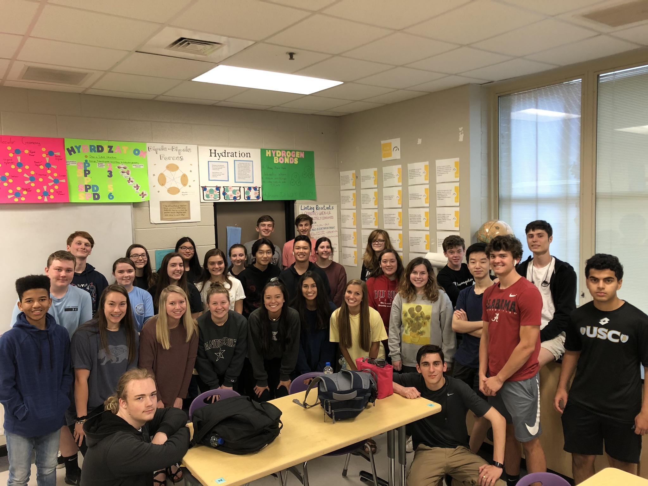
THE BEST PART :)

Slide 9
SCHEDULE
FALL | SPRING
Chemistry II | Chemistry I
Pre-AP Chemistry I | Chemistry I
Chemistry II | Planning
Planning | Chemistry I

Slide 10
CONTACT INFORMATION
EMAIL:
elharris@madisoncity.k12.al.us
PHONE:
Google Voice: 256-262-7857
School: 256-216-5313 ext. 95067

Slide 11
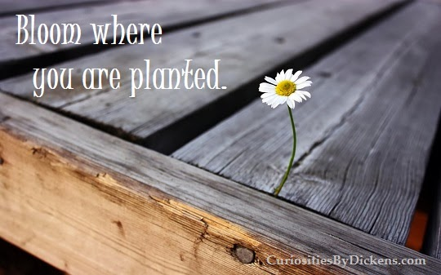

Slide 12
(Optional) Other ideas to add to this presentation:
Pictures of your pets and introduce them
List of your “favorites” (hobbies, food, places, movies, etc.)
Favorite quotes
Personal mission statement
College alma mater
Links to your favorite resources in your course
Virtual classroom expectations
Address the elephant in the room. Speak to the fact that we would all love to be back in the building together, and we will get back to that point. However, this is where we are and what we have to do for now. We will make this a great experience, and we will all grow from it. End the presentation on a positive note

